Slide 1


COUNTRY DATA ANALYSIS USING MONGODB
Exploring the power of mongoDB for in-depth Country Population and area data analysis
Presented by Keshav Tiwari

Slide 2


Introduction
Understanding the key aspects of MongoDB for World population in every 10years and growth rate and many other things for different-different companies to market their audience
NoSQL Database with Flexible JSON-like Documents
Dynamic Schemas for Performance and Scalability
Document-oriented Storage
Powerful Aggregation Framework

Slide 3






DATASET OVERVIEW
Unique _id
Population
1980/2000
Country Place
Population
2010/2022-23
Rank
Country Name
Expected :
Population
2030/2050
World Percentage
Country Area
Growth Rate

Slide 4







DATA ANALYSIS QUERIES
COUNTRY DATA ANALYSIS ON POPULATION BASES

Slide 5


How find works in mongoDB ??
The find() method in MongoDB selects documents in a collection or view and returns a cursor to the selected documents.
It takes a query object as a parameter and returns all documents that match the query.
The query object contains one or more key-value pairs.
How aggrigation framework works in mongoDB ??
The MongoDB Aggregation Framework is used to design a pipeline of multiple stages for processing documents. Each stage performs specific operations on documents, such as filtering, grouping, sorting, and selecting fields

Slide 6


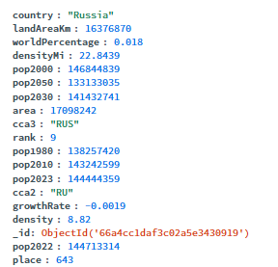

1. Total countries in this dataSet
Use db.collection.find({}) to retrieve all documents in the specified collection.
2 Find all documents where the field “population” greater than 1000000000
: db.data.find({pop2023:{$gte: 1000000000}}).count()
3. Which country has the lowest population density among the top 10 most populous countries?
db.countries.aggregate([
{ $sort: { population: -1 } },
{ $limit: 10 },
{ $sort: { density: 1 } },
{ $limit: 1 }
])

Slide 7
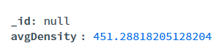
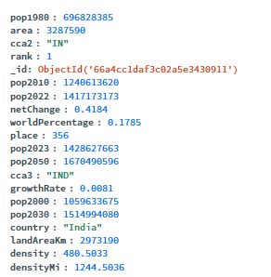
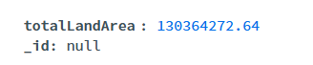
4. What is the average population density across all countries?
db.countries.aggregate([
{ $group: { _id: null, avgDensity: { $avg: "$density" } } }
])
5. Which country has the highest net population change rate?
db.countries.aggregate([
{ $sort: { netChange: -1 } },
{ $limit: 1 }
])
6. What is the total land area of all countries combined?
db.countries.aggregate([
{ $group: { _id: null, totalLandArea: { $sum: "$landAreaKm" } } }
])

Slide 8
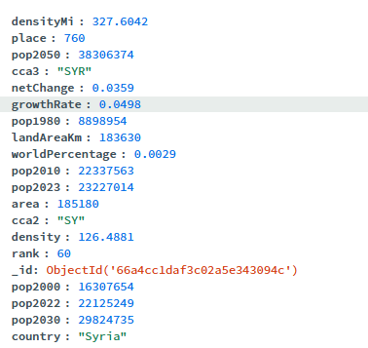
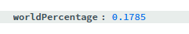

7. Which country has the highest growth rate?
db.countries.aggregate([
{ $sort: { growthRate: -1 } },
{ $limit: 1 }
])
8. What percentage of the world’s population does India represent
db.countries.aggregate([
{ $match: { country: "India" } },
{ $project: { _id: 0, worldPercentage: 1 } }
])
9. Which country has the smallest population in 2023?
db.countries.aggregate([
{ $sort: { pop2023: 1 } },
{ $limit: 1 }
])

Slide 9

10. What is the rank of China in terms of population?
db.countries.aggregate([
{ $match: { country: "China" } },
{ $project: { _id: 0, rank: 1 } }
])
11. Which country has the highest population growth between 2022 and 2030
db.countries.aggregate([
{ $project: { _id: 0, country: 1, growthDiff: { $subtract: ["$pop2030", "$pop2022"] } } },
{ $sort: { growthDiff: -1 } },
{ $limit: 1 }
])
12. What is the world rank of Indonesia in terms of land area?
db.countries.aggregate([
{ $match: { country: "Indonesia" } },
{ $project: { _id: 0, rank: 1 } }
])

Slide 10

Valuable Insights
COUNTRIES DATA ANALYSIS
CONCLUSION
Effective Data Analysis
eNHANCING THE WORLD POPULATION DATA ANALYSIS OF ALL COUNTRIES WITH MONGODB
Actionable Business Insights

Slide 11
ACKNOWLEDGEMENT
Recognizing key Contributors to Project Success
Mr. Prajjal Dhar provided curtail insights and guidance, significantly impacting project outcomes.

Slide 12

Presented by Keshav Tiwari
Thank you very much!

